Slide 1
The NOUMENAL against(?) the PHENOMENAL
CRITICAL THEORIES IN THE VISUAL ARTS

Slide 2
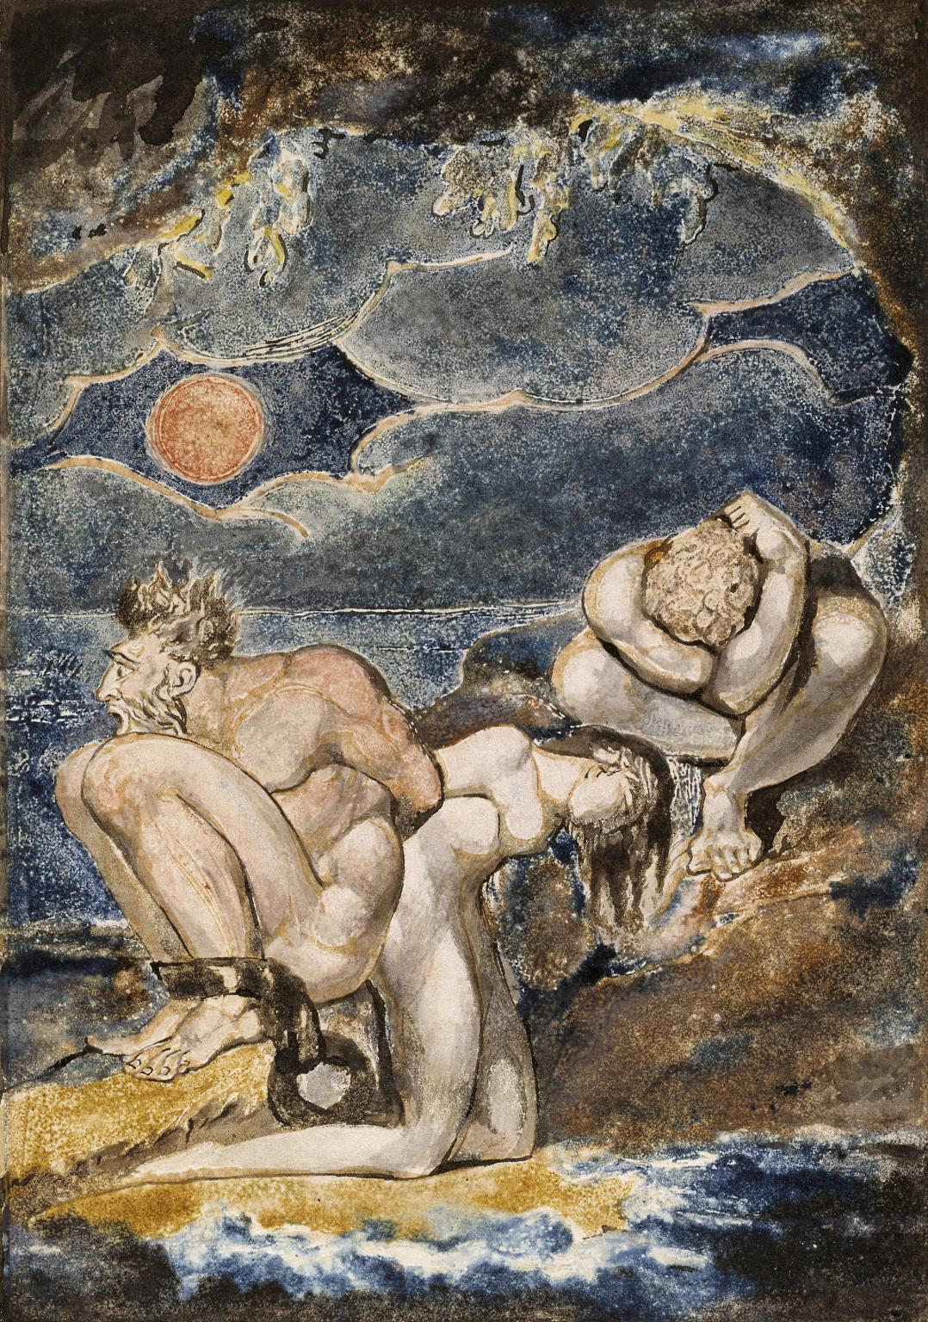
Romanticism
Term in use by the early nineteenth century to describe the movement in art and literature distinguished by a new interest in human psychology, expression of personal feeling and interest in the natural world
William Blake Frontispiece to ‘Visions of the Daughters of Albion’ c.1795 Tate

Slide 3
KANT, SCHILLER
KANT – The effect produced by the “beautiful” object is to set our understanding and imagination in “free play” with one another, and it is the pleasure generated by this free play that leads us to judge the object to be beautiful (Kant, 98, 102–3).(1790)
SCHILLER - , beauty is “freedom in appearance, autonomy in appearance” (Schiller, 151). Schiller insists that freedom itself is something “noumenal” to use Kant's terminology and so can never actually manifest itself in the realm of the senses. We can never see freedom at work in, or embodied in, the world of space and time. In the case of beautiful objects, therefore—whether they are the products of nature or human imagination—“it is all that matters [ ... ] that the object appears as free, not that it really is so” (Schiller, 151).

Slide 4
HEGEL, HAZLITT
HEGEL - agrees with Schiller (against Kant) that beauty is an objective property of things. In his view, however, beauty is the direct sensuous manifestation of freedom, not merely the appearance or imitation of freedom. It shows us what freedom actually looks like and sounds like when it gives itself sensuous expression
Hegel's Aesthetics First published Tue Jan 20, 2009; substantive revision Tue Feb 2, 2016
HAZLITT - I deny in toto and at once the exclusive right and power of painters to judge of pictures. What is a picture meant for? To convey certain ideas to the mind of painters? That is, of one man in ten thousand? – No, but to make them apparent to the eye and mind of all. If a picture be admired by none but painters, I think it is strong presumption that the picture is bad.
William Hazlitt, ‘on judging of pictures’ (1823), in the complete works of William Hazlitt, ed. By P.P. Howe, 21 vols., London 1930–4, vol.18, p.182.

Slide 5
KEATS
Keats 1795-1821 - Ode on a Grecian Urn –
"Beauty is truth, truth beauty,—that is all
Ye know on earth, and all ye need to know.“
probably written in May 1819
Hegel also held lectures on aesthetics in Heidelberg in 1818 and in Berlin in 1820/21 (winter semester), 1823 and 1826 (summer semesters), and 1828/29 (winter semester).

Slide 7
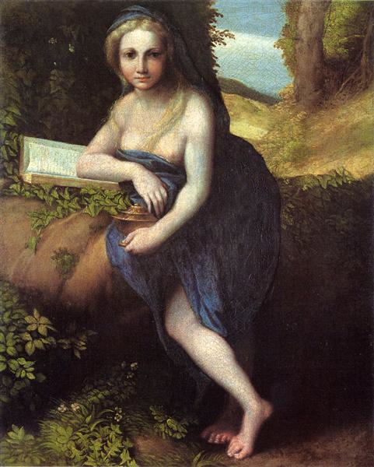
The ABSOLUTE
Correggio … saw and felt for himself; he was of no school, but had his own world of art to create. That image of truth and beauty, which existed in his mind, he was forced to construct for himself, without rules or model. As it has arisen in his mind from the contemplation of nature, so he could only hope to embody it to others, by the imitation of nature … – Such is always the true progress of art.
William Hazlitt, ‘Whether the Fine Arts are Promoted by Academies’ (1814), in Hazlitt 1930–4, vol.18, p.42.
Corregio, The Magdalane, 1519

Slide 8
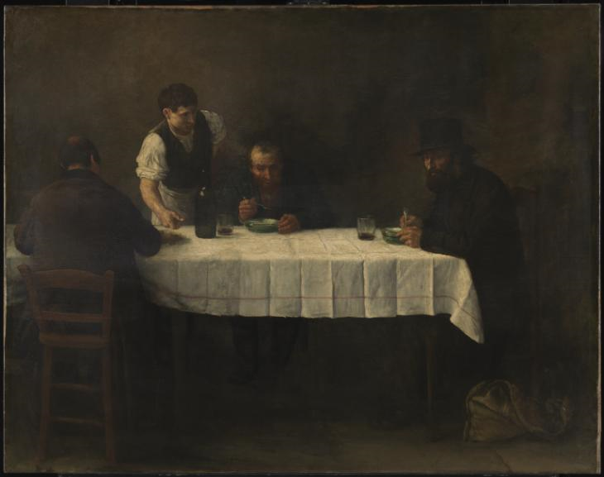
Realism
In its specific sense realism refers to a mid nineteenth century artistic movement characterised by subjects painted from everyday life in a naturalistic manner; however the term is also generally used to describe artworks painted in a realistic almost photographic way
Alphonse Legros Le Repas des Pauvres 1877 Tate

Slide 9
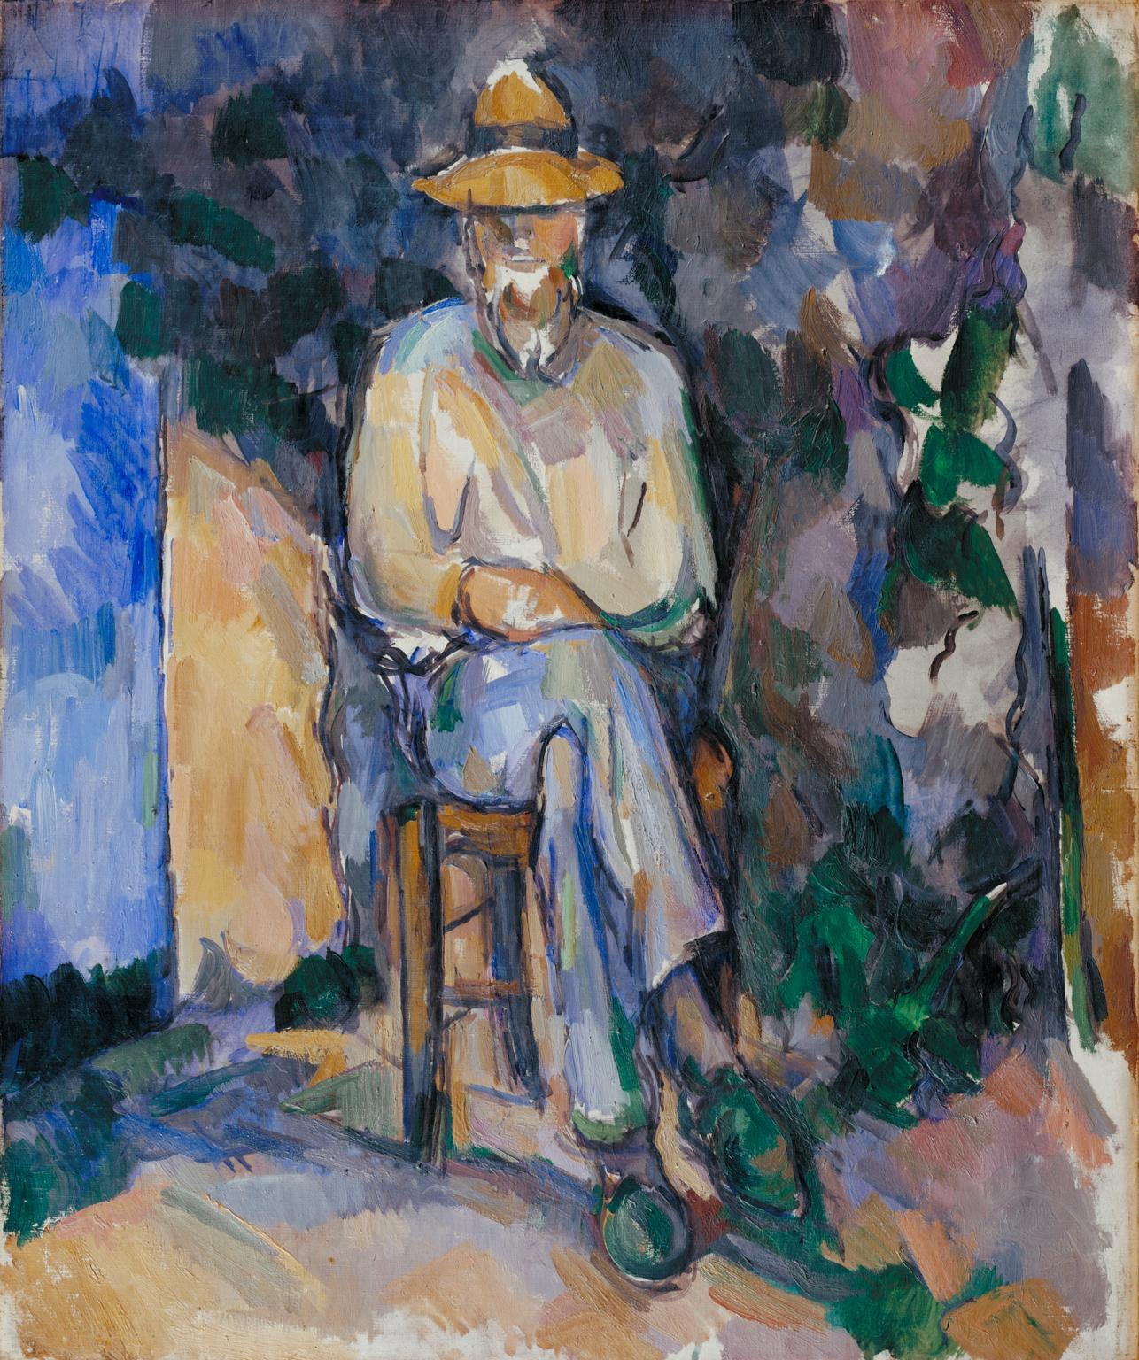
Formalism
Formalism is the study of art based solely on an analysis of its form – the way it is made and what it looks like
Paul Cézanne The Gardener Vallier c.1906 Tate

Slide 10
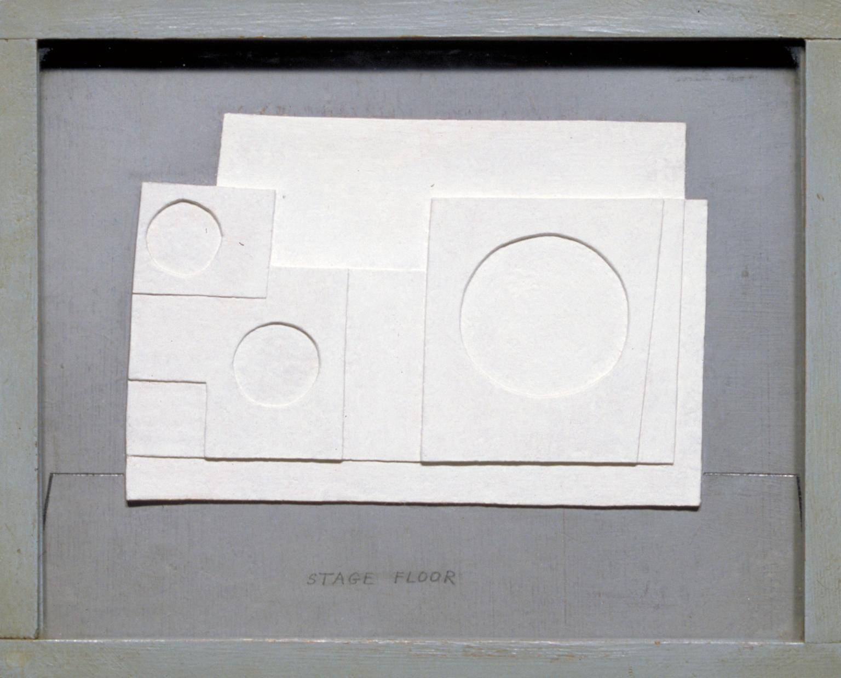
Modernism
Modernism refers to the broad movement in Western arts and literature that gathered pace from around 1850, and is characterised by a deliberate rejection of the styles of the past; emphasising instead innovation and experimentation in forms, materials and techniques in order to create artworks that better reflected modern society
Ben Nicholson OM 1934 project for Massine for Beethoven 7th Symphony Ballet 1934 Tate © Angela Verren Taunt 2018. All rights reserved, DACS

Slide 11
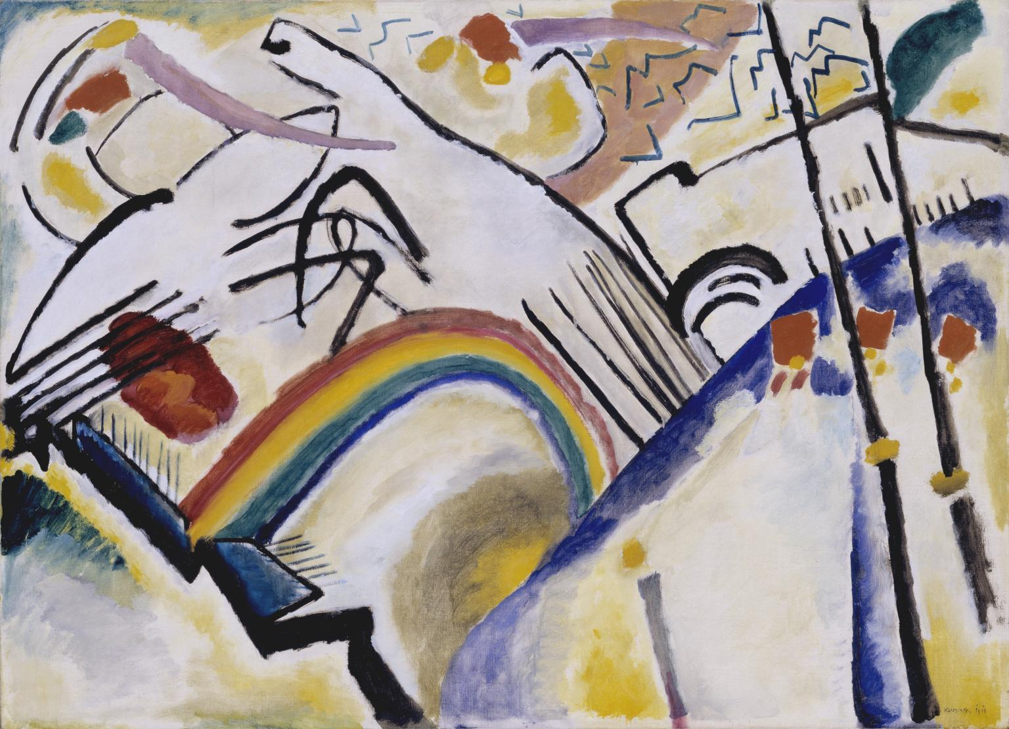
Abstraction
Abstract art is art that does not attempt to represent an accurate depiction of a visual reality but instead uses shapes, colours, forms and gestural marks to achieve its effect
Wassily Kandinsky Cossacks 1910–1 Tate

Slide 12
CUBISM
Alfred Hamilton Barr Jr. (January 28, 1902 – August 15, 1981) was an American art historian and the first director of MOMA in New York City. From that position, he was one of the most influential forces in the development of popular attitudes toward modern art; for example, his arranging of the blockbuster Van Gogh exhibition of 1935, in the words of author Bernice Kert, was "a precursor to the hold Van Gogh has to this day on the contemporary imagination.

Slide 13
ABSTRACT EXPRESSIONISM
Greenberg vs Rosenberg
Clement Greenberg (January 16, 1909 – May 7, 1994), was an American essayist known mainly as an influential visual art critic. In particular, he was among the first published critics to praise the work of painter Jackson Pollock.
Harold Rosenberg (February 2, 1906 – July 11, 1978) was a writer, educator, philosopher and art critic. He coined the term Action Painting in 1952 for what was later to be known as abstract expressionism.

Slide 14
GREENBERG vs ROSENBERG
Where the Old Masters created an illusion of space into which one could imagine walking, the illusion created by a Modernist is one into which one can look, can travel through, only with the eye. Clement Greenburg.
You like it, that's all, whether it's a landscape or abstract. You like it. It hits you. You don't have to read it. The work of art-sculpture or painting-forces your eye. Clement Greenburg.
The differences between revolution in art and revolution in politics are enormous. Revolution in art lies not in the will to destroy but in the revelation of what has already been destroyed. Art kills only the dead. Harold Rosenberg
Only conservatives believe that subversion is still being carried on in the arts and that society is being shaken by it. Advanced art today is no longer a cause - it contains no moral imperative. There is no virtue in clinging to principles and standards, no vice in selling or in selling out. Harold Rosenberg

Slide 15
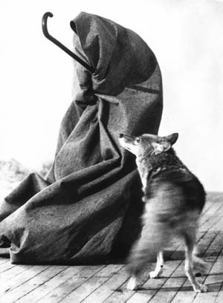
CONCEPTUAL ART
Conceptual art is art for which the idea (or concept) behind the work is more important than the finished art object. It emerged as an art movement in the 1960s and the term usually refers to art made from the mid-1960s to the mid-1970s.
Joseph Beuys I like America and America likes me
Action: Beuys referred to his performance works as actions.
His most famous action, I Like America and America Likes Me
took place in May 1974. Beuys wrapped himself in felt and
spent three days in a room with a coyote.
The work was an expression of his anti-Vietnam War stance,
and also reflected his beliefs about the damage done to the
American continent and its native cultures by European settlers.
Photo credit Caroline Tisdall © DACS 200

Slide 16
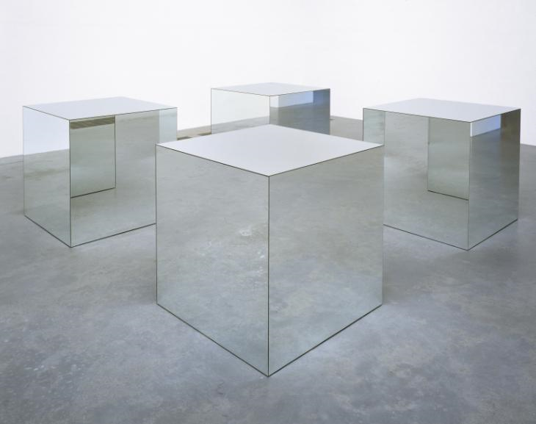
MINIMALISM
Minimalism is an extreme form of abstract art developed in the USA in the 1960s and typified by artworks composed of simple geometric shapes based on the square and the rectangle
Robert Morris Untitled 1965, reconstructed 1971 Tate © ARS, NY and DACS, London 2018

Slide 17
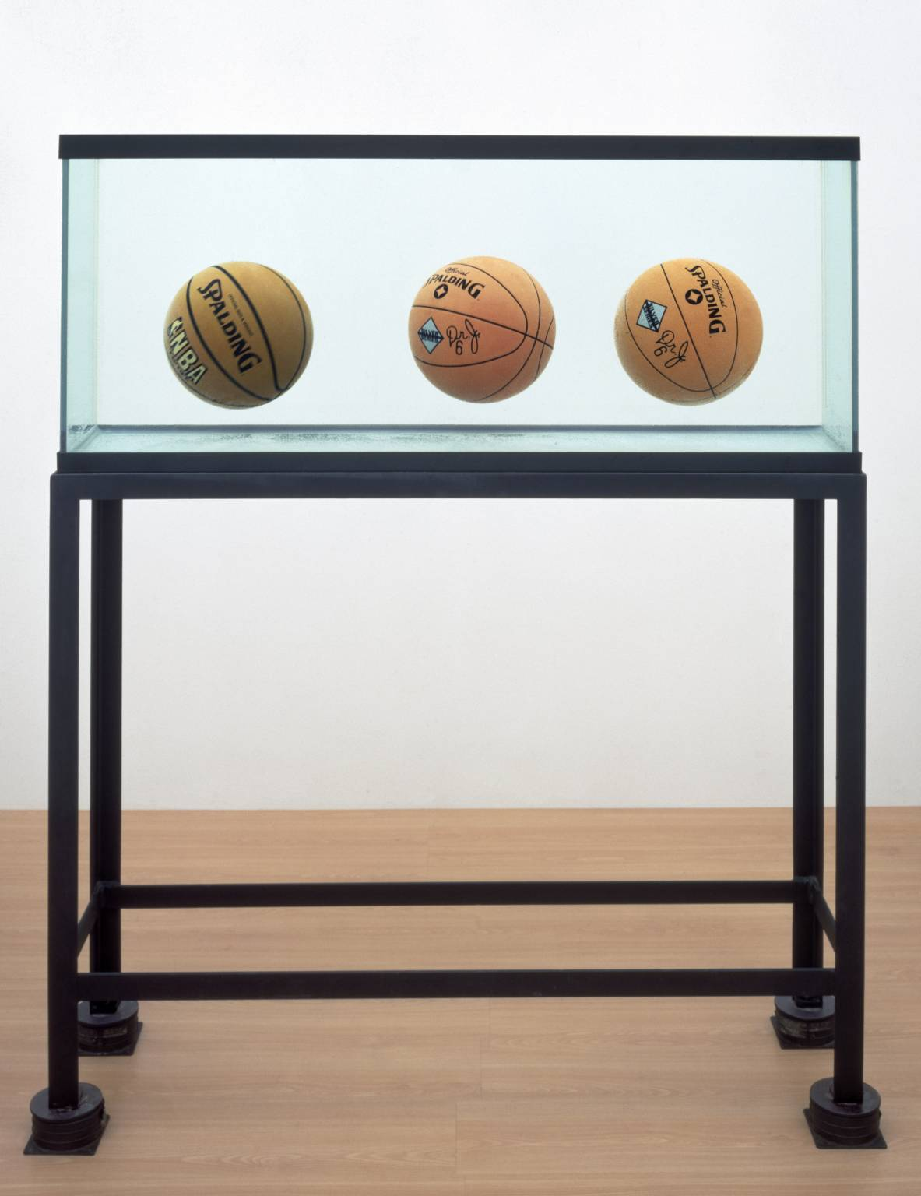
POSTMODERNISM – DIALECTICAL MATERIALISM
In art, postmodernism was specifically a reaction against modernism which had dominated art theory and practice since the beginning of the twentieth century. The term postmodernism is also widely used to describe challenges and changes to established structures and belief systems that took place in Western society and culture from the 1960s onwards.
Jeff Koons Three Ball Total Equilibrium Tank (Two Dr J Silver Series, Spalding NBA Tip-Off) 1985 Tate © Jeff Koons

Slide 18
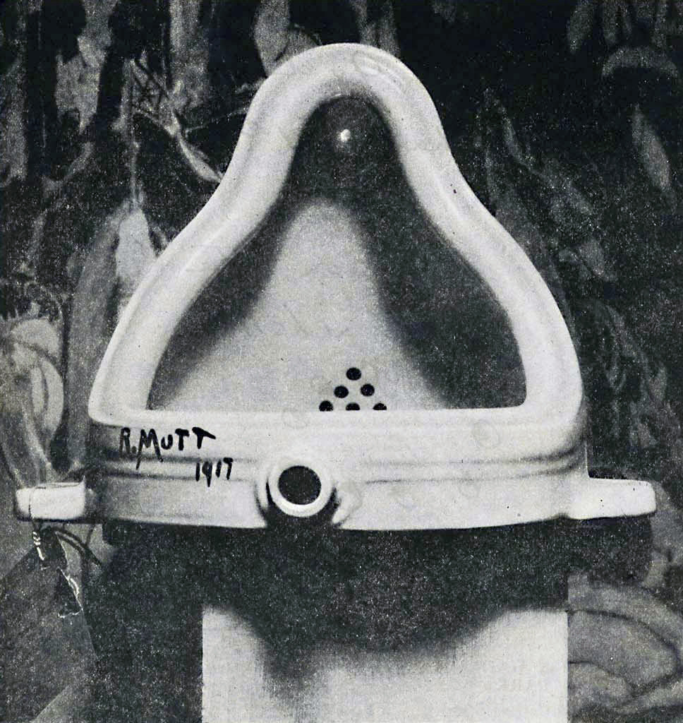
dialectical materialism
Marxist theory that maintains the material basis of a reality constantly changing in a dialectical process and the priority of matter over mind
Walter Benjamin: Philosophy deals with the ‘realm of ideas’. Phenomena and objects enter into the realm of ideas only partially, through their essences. (A phenomenon, literally an observable occurrence, refers in philosophy to empirical things, objects, events, beings and so on). For Benjamin, this process is a kind of transubstantiation which redeems phenomena and objects. It rescues them from their construction as part of the existing system, and allows them to be reinscribed in new mosaics and combinations.

Slide 19
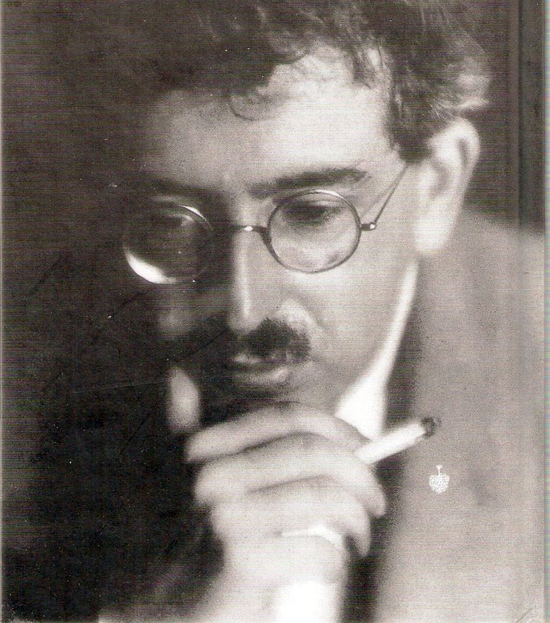
BENJAMIN
“even the most perfect reproduction of a work of art is lacking in one element: Its presence in time and space, its unique existence at the place where it happens to be.”
The Work of Art in the Age of Mechanical Reproduction (1935, Das Kunstwerk im Zeitalter seiner technischen Reproduzierbarkeit)

Slide 20
POP – THE END OF MODERNISM
Pop art is an art movement that emerged in the 1950s and flourished in the 1960s in America and Britain, drawing inspiration from sources in popular and commercial culture. Different cultures and countries contributed to the movement during the 1960s and 70s
© Estate of Roy Lichtenstein
Brushstroke
1965

Slide 21
POSTMODERN POP AND OTHER SIMULATIONS
To dissimulate is to feign not to have what one has. To simulate is to feign to have what one hasn't. One implies a presence, the other an absence.
The simulacrum is never that which conceals the truth--it is the truth which conceals that there is none.
The simulacrum is true.
Jean Baudrillard

Slide 22
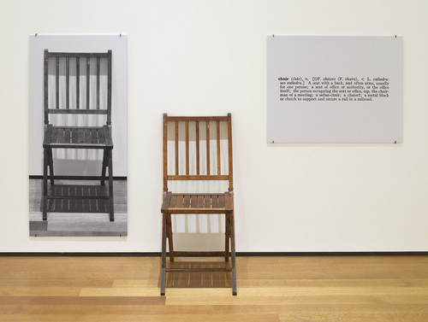
SEMIOTICS
“Works of art are analytic propositions. That is, if viewed within their context – as art – they provide no information whatsoever about any matter of fact. A work of art is a tautology in that it is a presentation of the artist’s intention, that is, he is saying that that particular work of art is art, which means, is a definition of art.” Joseph Kosuth, “Art After Philosophy,” in Art After Philosophy and After: Collected Writings, 1960–1990 (Cambridge: MIT Press, 1991)

Slide 23
POST STRUCTURALISM
Passe-Partout
Someone, not me, comes and says the words : "I am interested in the idiom in painting."
You get the picture: the speaker is impassive, he remained motionless for the duration of his sentence, careful to refrain from any gesture. At the point where you were perhaps expecting it, near the head and around certain words, for example "in painting," he did not imitate the double horns of quotation marks, he did not depict a form of writing with his fingers in the air. He merely comes and announces to you: "I am interested in the idiom in painting."
The Truth in Painting
Jacques Derrida
Post-structuralism offers a way of studying how knowledge is produced and critiques Structuralist premises. It argues that because history and culture condition the study of underlying structures, both are subject to biases and misinterpretations. A Post-structuralist approach argues that to understand an object (e.g., a text), it is necessary to study both the object itself and the systems of knowledge that produced the object.

Slide 24
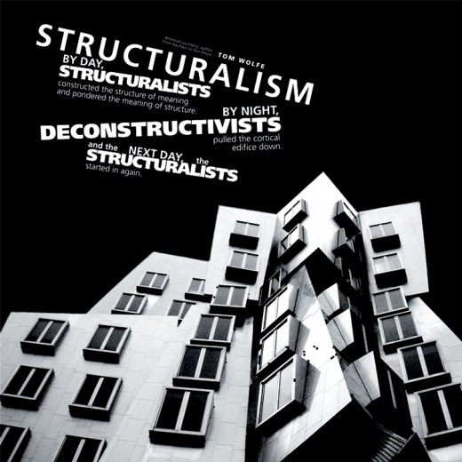
STRUCTURALISM
structuralism is the methodology that implies elements of human culture must be understood by way of their relationship to a larger, overarching system or structure. It works to uncover the structures that underlie all the things that humans do, think, perceive, and feel.

Slide 25
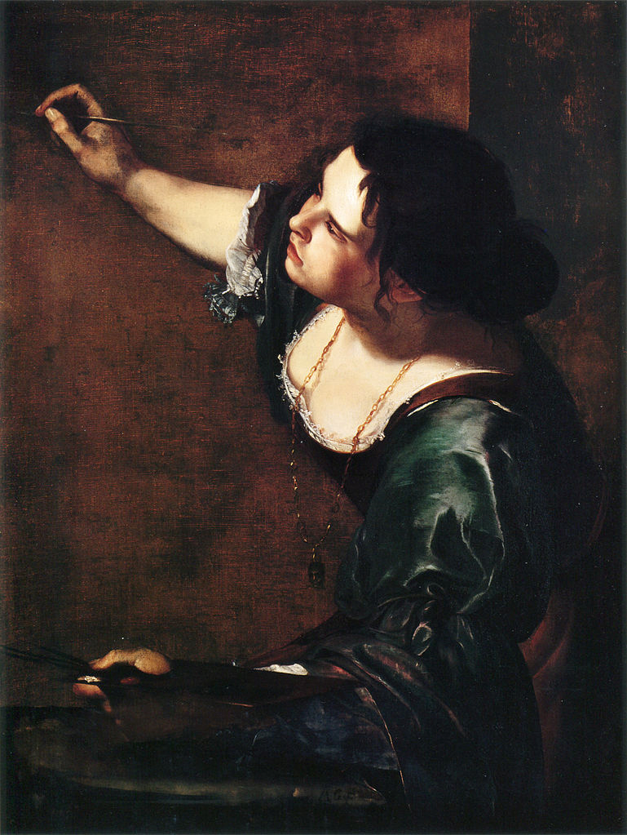
FEMINIST CRITICISM
The language of art is, […], embodied in paint and line on canvas or paper, in stone or clay or plastic or metal it is neither a sob story nor a confidential whisper.
The fact of the matter is that there have been no supremely great women artists, as far as we know, although there have been many interesting and very good ones who remain insufficiently investigated or appreciated; nor have there been any great Lithuanian jazz pianists, nor Eskimo tennis players, no matter how much we might wish there had been.
Why Have There Been No Great Women Artists? by Linda Nochlin
Extract from Women, Art and Power and Other Essays, Westview Press, 1988 by Linda Nochlin, pp.147158

